Slide 1

Credit Lending HLA
By Riya Sharma
14 March, 2025

Slide 2
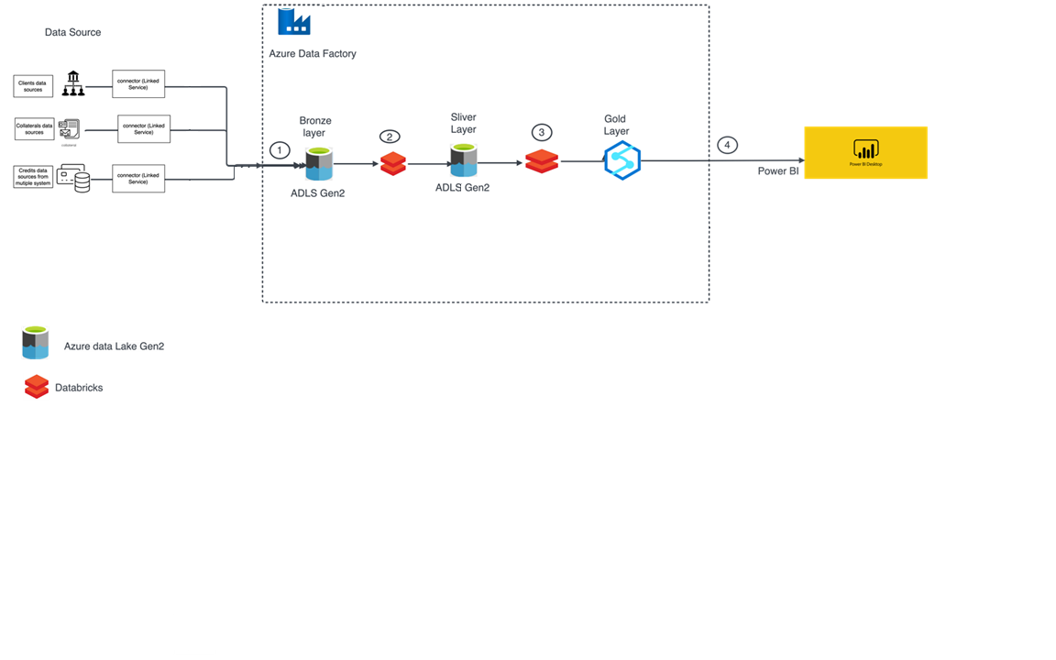
High Level Architecture

Slide 3
Components
Ingestion → Storage(ADLS 2):
ADF: Manages and automates data pipelines(Schedule Triggers).
Event Hubs: Handles real-time data intake.
Storage → Processing:
Databricks: Processes and refines data.
Stream Analytics: Streams and outputs data.
Analytics → BI:
Power BI: Visualizes insights from data.

Slide 4
ETL Process
Extraction:
Azure Data Factory: Connects to various sources via native connectors.
Transformation:
Databricks: Utilizes Apache Spark for transformation rules and complex data processing.
Loading:
ADF: Automates the loading process into various targets.
Data Versatility:
ADF: Handles structured and semi-structured data (JSON, CSV, Parquet).
Azure Blob Storage: Stores unstructured data and integrates with other Azure services

Slide 5
Thank You

